Slide 1
Online Chatbot Based Ticketing System
CSE7301 Capstone Project
Review-2
Batch Number:
Under the Supervision of,
Mr. Syed Mohsin
School of Computer Science and Engineering
Presidency University
Roll Number | Student Name
20211CSE0631 | Prashanth S N
20211CSE0666 | Nithin H M
20211CSE0889 | Kanala Krishna Samhith
Name of the Program: CSE
Name of the HoD: Dr. Asif Mohammed H.B
Name of the Program Project Coordinator: Mr. Syed Mohsin
Name of the School Project Coordinators: Dr. Sampath A K / Dr. Abdul Khadar A / Mr. Md Ziaur Rahman

Slide 2
Content
Introduction
Literature Survey
Objectives
Existing Methods-Drawbacks
Proposed Method
Architecture Diagram
Modules
Hardware and Software Details
Time Line by Gantt Chart
GitHub Link
References

Slide 3
Introduction
Manual ticketing systems in museums often result in long queues, inefficiencies, and errors that negatively impact the visitor experience. During peak hours, weekends, and special events, these issues become more prominent, leading to customer dissatisfaction and operational delays. Inaccurate ticket issuance, double bookings, and lost records further strain the system, damaging both reputation and revenue.
To overcome these challenges, this project proposes an AI-powered chatbot-based ticketing system that automates the entire booking process—from gate entries to event passes. The chatbot offers a seamless, conversational interface for users to book, cancel, and manage tickets, while also integrating with secure payment gateways for end-to-end automation.

Slide 4
Literature Survey
Highlights the use of chatbots in customer service and ticketing systems in travel and tourism.
Examines existing ticket booking systems in museums, focusing on manual and online systems.
Discusses the integration of NLP into chatbots for improving communication and customer support.
Focuses on how chatbots can enhance user experience and accessibility in cultural institutions.
Focuses on the role of chatbots in enhancing user experience in web-based systems.

Slide 5
Literature Survey
Key Technologies Explored:
MERN Stack: MongoDB, Express.js, React, Node.js used for full-stack development. (Link)
Relevant Works:
Chatbot-based ticketing in airlines: Reference: https://ieeexplore.ieee.org/document/9058283
Tourism chatbot case studies: Reference: https://www.sciencedirect.com/science/article/pii/S1877050920304041

Slide 6
Objectives
Main Objective
To develop an automated chatbot-based ticketing system for museums to streamline ticket booking and improve the overall visitor experience.
Specific Objectives
Develop a chatbot capable of handling ticket bookings for museum entry and shows.
Integrate a payment gateway for secure online payments.
Create an analytics dashboard to collect and analyze user data for operational insights.
Automate the ticketing process to reduce human errors and improve efficiency.

Slide 7
Existing Methods & Drawbacks
Manual Ticket Counter
Long queues and human errors.
Mobile Apps
Require app downloads, device compatibility issues.
Email or Phone-based Ticketing
Manual data entry, prone to errors.

Slide 8
Drawbacks of Existing Methods
Inefficiency & Long Wait Times
Human Errors in Ticketing
Lack of Real-time Data
Limited Customer Support
Scalability Issues
Accessibility Problems
High Operational Costs

Slide 9
Proposed Method
Improved Customer Service
Efficient Handling of High Volumes
Cost-Effective Solution
Data Collection and Analysis
Accessibility and Reduced Human Error
Enhanced Marketing and Promotion Expected Solution

Slide 10
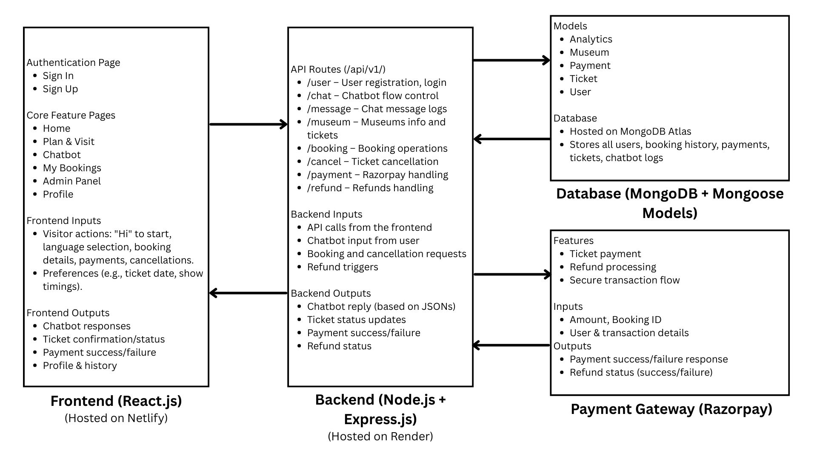
Architecture Diagram

Slide 11
Modules
Chatbot Module: Handles user interactions, queries, and booking confirmations.
Payment Module: Manages transactions through secure gateways.
Database Module: Stores visitor data, ticket information, and transaction details.
Analytics Module: Collects user data and generates insights for museum management.

Slide 12
Hardware and Software Details
Software Requirements:
1. Operating System
Windows, macOS, or Linux: Any modern OS capable of running development environments.
2. Development Environment
Code Editor: Visual Studio Code.
Node.js: For back-end development and running JavaScript on the server side.
Database Management Tool: MongoDB.
3. Version Control
Git: For managing version control and collaboration.
GitHub: For hosting the repository.

Slide 13
Hardware and Software Details
Hardware Requirements:
1. Development Machine
Processor: Intel i5 (or equivalent AMD) or higher.
RAM: 8GB or more for handling multiple tasks such as running the local server, browser, and development tools simultaneously.
Storage: 256GB SSD or more for faster performance and to handle development tasks quickly.
2. Internet Connection
Stable broadband connection for accessing APIs, cloud storage, and deploying the application to cloud platforms.

Slide 14
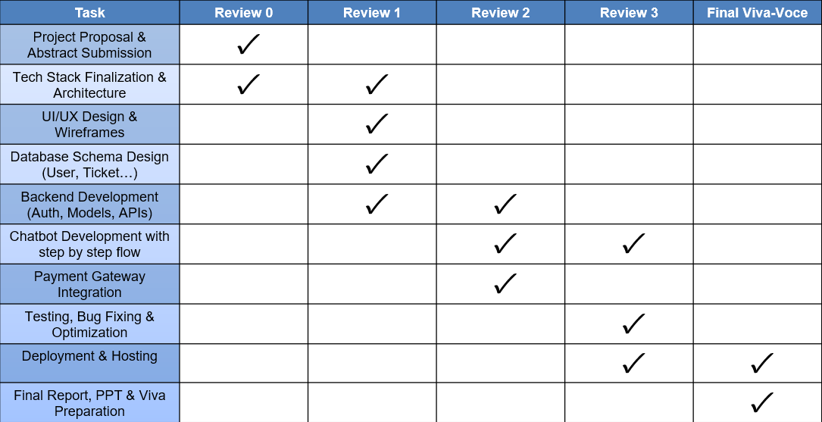
Timeline of the Project (Gantt Chart)

Slide 15
Github Link
The Github link provided should have public access permission.
Github Link
https://github.com/Prashanth0718/ONLINE-CHATBOT-TICKETING-SYSTEM

Slide 16
References(Referring Research Papers)
[1] Chatbots in Tourism Industry: A Survey (Link)
https://www.sciencedirect.com/science/article/pii/S1877050919310360
[2] A Study of Ticket Booking Systems in Museums (Link)
https://www.researchgate.net/publication/323908463_TiteleiInhaltsverzeichnis
[3] Natural Language Processing (NLP) for Customer Service Chatbots (Link)
https://www.researchgate.net/publication/341501101_Natural_Language_Processing_for_Customer_Service_Chatbots
[4] Exploring Chatbots in the Context of Museums and Cultural Heritage Sites (Link)
https://www.sciencedirect.com/science/article/pii/S187705091930960X
[5] Multilingual Support in Chatbots for Global Customer Engagement (Link)
https://www.sciencedirect.com/science/article/pii/S187705091930960X
[6] Machine Learning-Based Automated Ticketing System (Link)
https://www.researchgate.net/publication/329366058_Machine_Learning_Based_Automated_Ticketing_System
[7] Chatbot-Driven Customer Service Automation: A Review (Link)
https://www.researchgate.net/publication/334425199_Chatbot-driven_Customer_Service_Automation_A_Review
[8] A Comparative Analysis of Payment Gateways for E-Commerce (Link)
https://www.sciencedirect.com/science/article/pii/S1877050919310966
[9] Improving User Experience in Web Applications Using Chatbots (Link)
https://www.researchgate.net/publication/335562545_Improving_User_Experience_in_Web_Applications_Using_Chatbots

Slide 17


